Slide 1
Linguistic Data: Quantitative Analysis and Visualisation
School of Linguistics
Linguistic Theory and Language Description
Moscow 2024
Introduction to course

Slide 2
School of linguistics
Linguistic Theory and Language Description
Linguistic Data: Quantitative Analysis and Visualisation
Course contents
Python basics
Classes, functions, modules
Data storage & processing
Web-crawlers, SQL syntax, mysql
Text manipulation and analysis
Lemmatizaion, syntax parsing, NER
Vectorization
TF-IDF, Word2Vec, FastText, BERT
Visualization
Matplotlib, graphs

Slide 3
School of linguistics
Linguistic Theory and Language Description
Linguistic Data: Quantitative Analysis and Visualisation
Assessment
0.3 * Assignment1 + 0.3 * Assignment2 + 0.4 * Assignment3 + 0.2 * Bonus task
within a week of the distribution for the max. of 10 points, within two weeks for the max. of 8 points
Bonus: R&D
Project: full grade

Slide 4

School of linguistics
Linguistic Theory and Language Description
Linguistic Data: Quantitative Analysis and Visualisation
Zen of Python
Beautiful is better than ugly.
Explicit is better than implicit.
Simple is better than complex.
Complex is better than complicated.
Readability counts.
Guido van Rossum

Slide 5
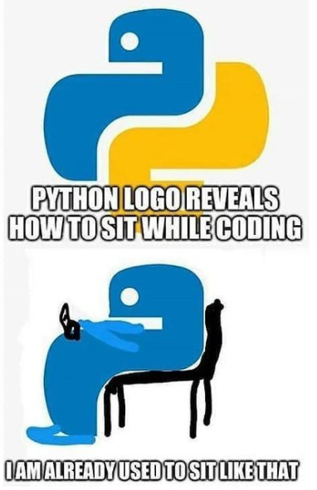
School of linguistics
Linguistic Theory and Language Description
Linguistic Data: Quantitative Analysis and Visualisation
Python (1991 — … )
3.13.0
GUI Programming Support
Object-Oriented Programming
Dynamic Language
Easy to Code
Free and Open-Source
High-level Programming Language
Interpreted Language
Libraries

Slide 6
School of linguistics
Linguistic Theory and Language Description
Linguistic Data: Quantitative Analysis and Visualisation
Python (1991 — … )
3.13.0
GUI Programming Support
Object-Oriented Programming
Dynamic Language
Easy to Code
Free and Open-Source
High-level Programming Language
Interpreted Language
Libraries

